Slide 1


FANTASY PREMIER LEAGUE
BY:-
RISHABH SHRIVASTAVA
DEEPAK GOPALAN
KEETI MURUGAN
PRIYANKA BANDEKAR
DANASHREE PATIL

Slide 2

SYSTEM
Our system simulates the official fantasy premier league application used by nearly 6 million users worldwide
There can be almost 38 game weeks with 10 fixtures each game week
Each user chooses set of 11 players every week.Every user is given 100 points to select the team of 11 players(Goalkeeper, Forward, MidFielder, Defence).
Each user participates in multiple leagues
Player Performance is gathered every week based on the fixtures for a chosen game week
Users compete against each other in a given league based on points scored by their respective teams

Slide 3

Summary of Design
Tables:
User
UserLeagues
Leagues
MyTeam
GameWeek
Fixtures
MyTeamPlayers
Players
PlayerPerformance
FixtureStats
PlayerPosition
Teams

Slide 4
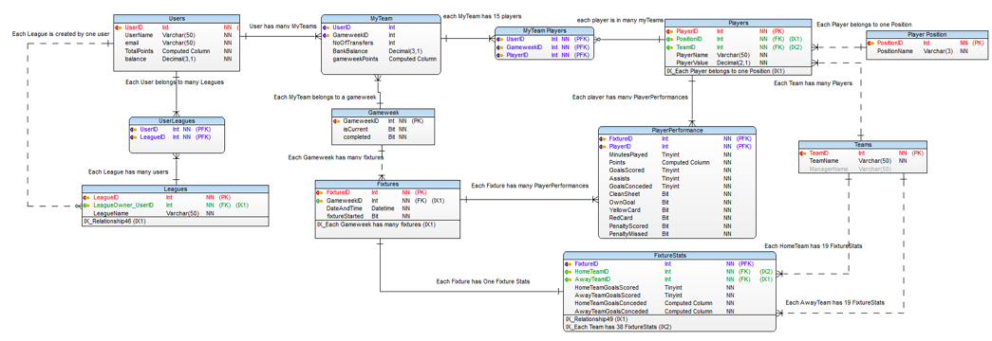
Flow of system:-

Slide 5
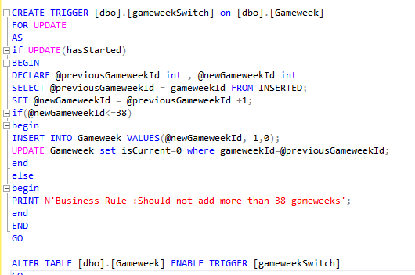
Triggers
Trigger switches the previous game week to 0 and the current gameweek to 1

Slide 6
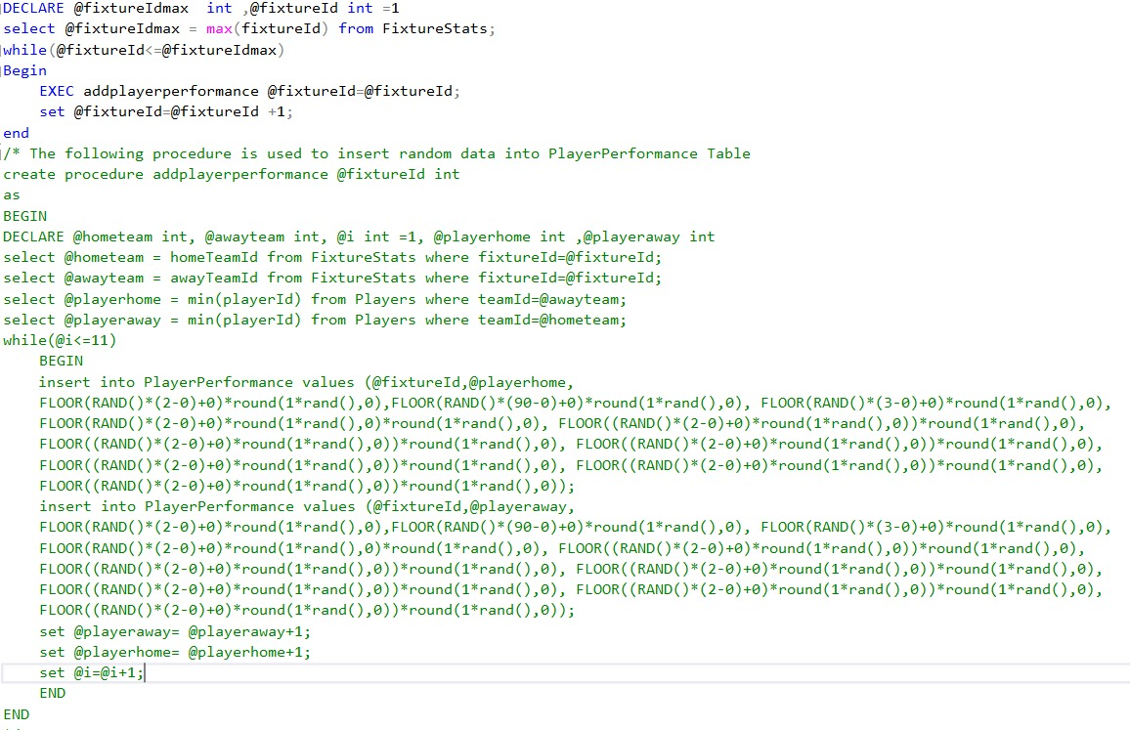
Store Procedures
Adding random data into PlayerPerformance

Slide 7
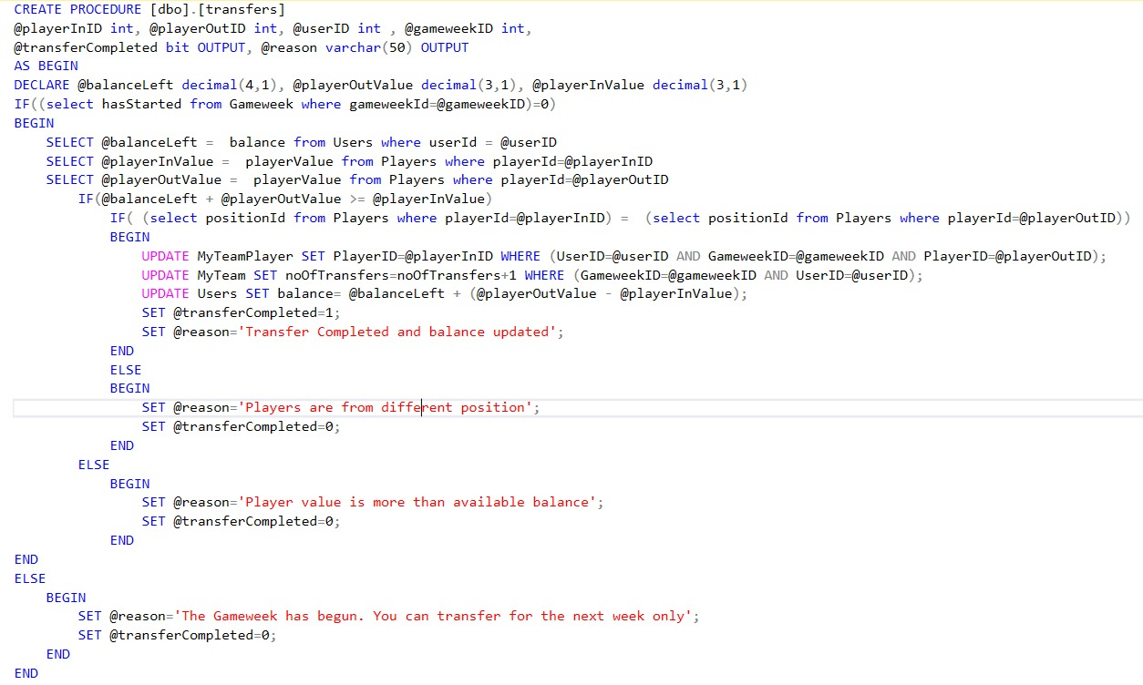
Store Procedures
Performing a transfer?

Slide 8
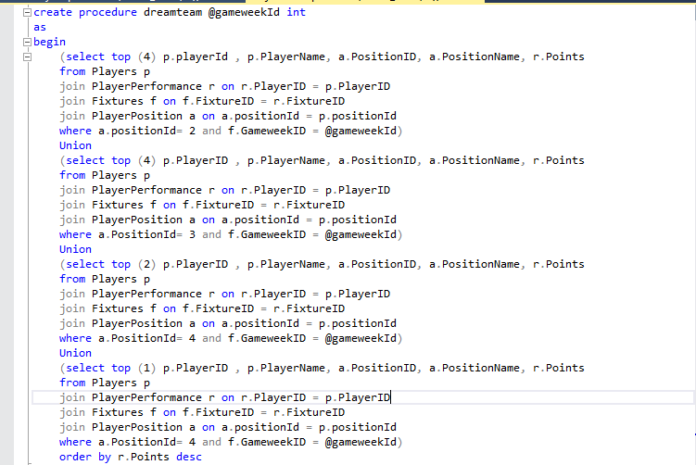
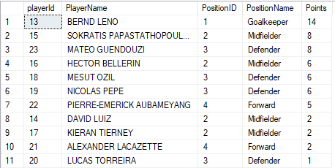
Store Procedures
11 Best Performing Players for particular Gameweek

Slide 9
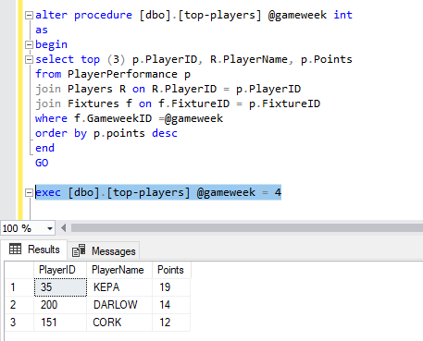
Store Procedures
Top 3 Players in a GameWeek

Slide 10
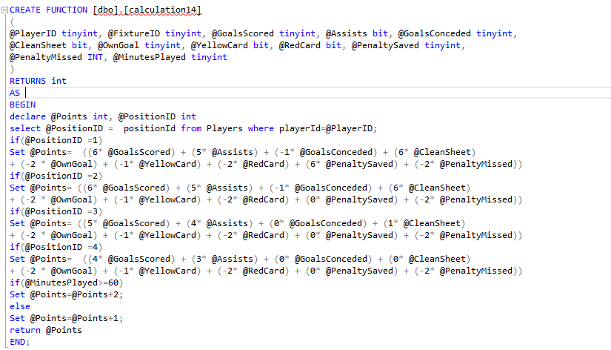
Function
Computed Column ‘Point’ in PlayerPerformance using Function

Slide 11
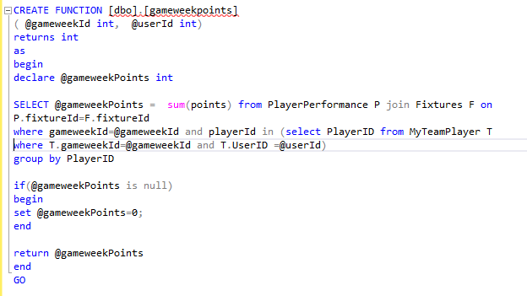
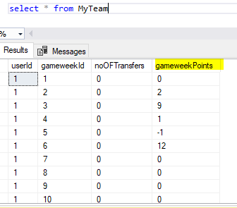
Function
Gameweekpoints function is used in the computed column gameweekpoints in myTeam Table

Slide 12
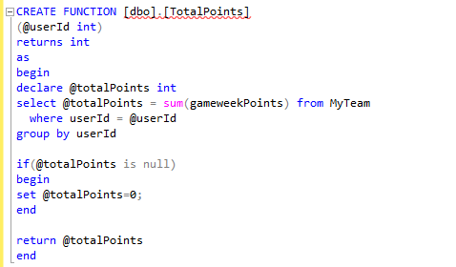
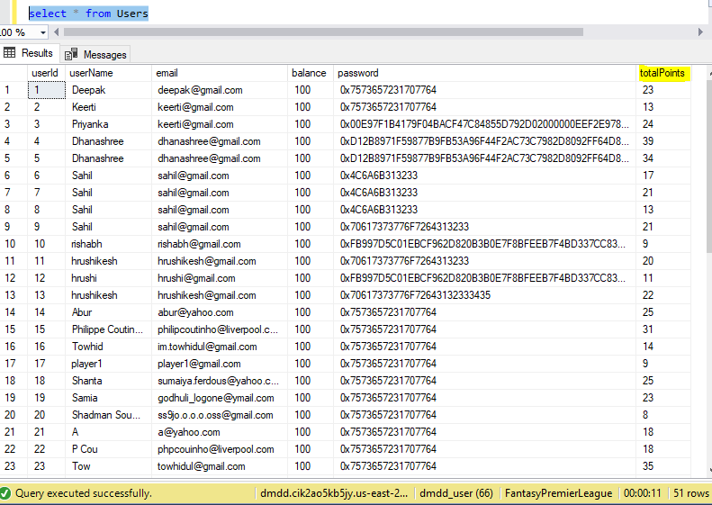
Function
Calculates Computed Column “TotalPoints” in users table in UDF

Slide 13
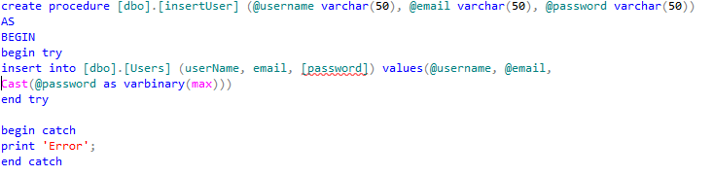
Encryption
Encryption for password in Users Table

Slide 14
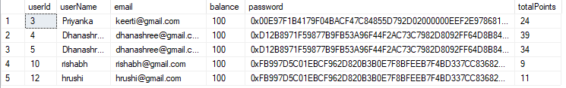
Encryption
Password Encryption

Slide 15
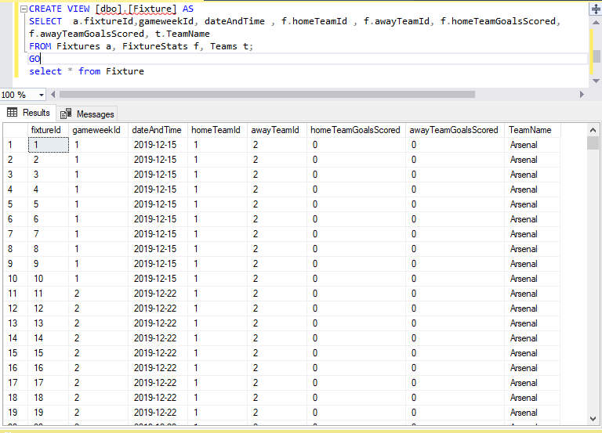
Views
View created on fixture table to view fixtures of the games

Slide 16
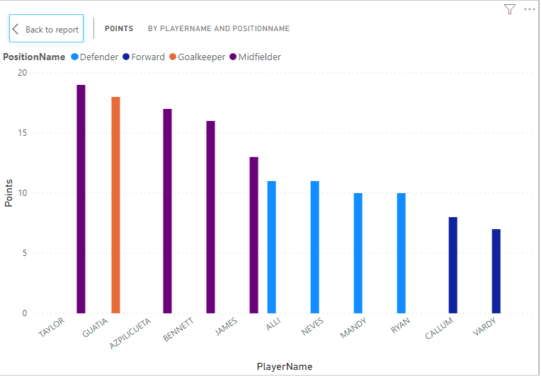
Users Cases
Dreamteam with 4 midfielders,4 defenders ,2 forward and 1 goalkeeper

Slide 17
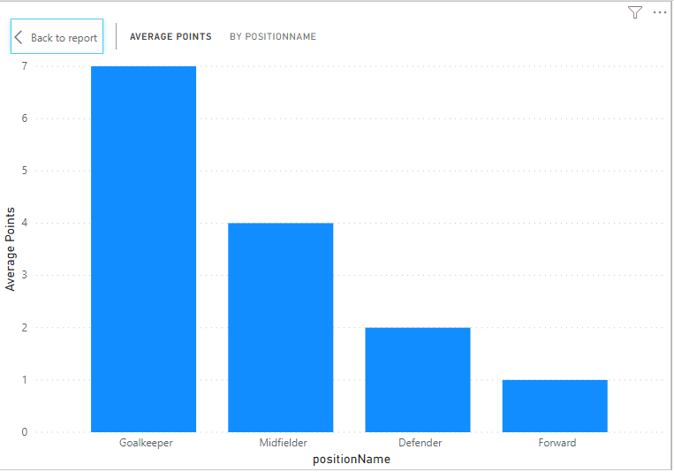
Users Cases
Average Points scored according to the player position

Slide 18
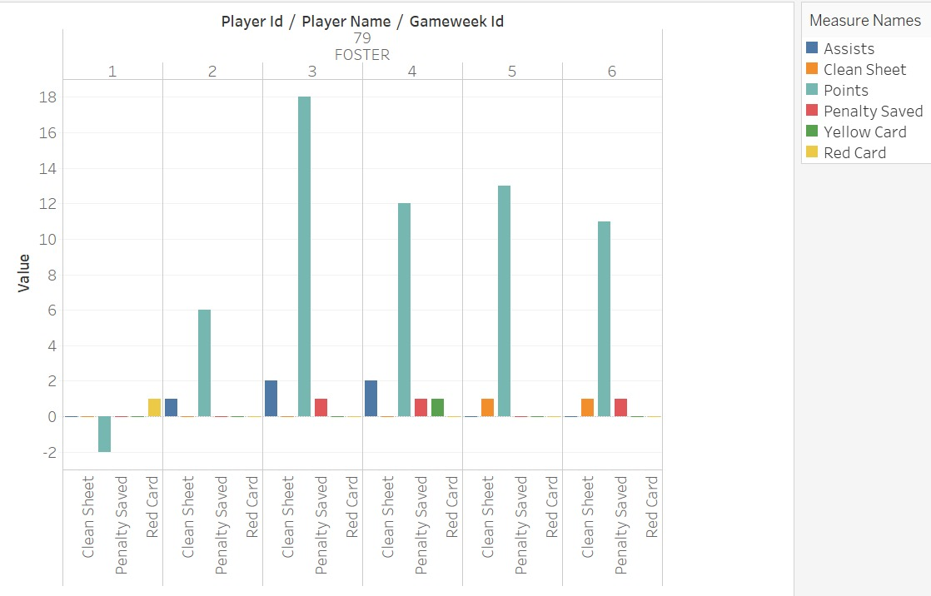
Users Cases
Performance history of overall best goalkeeper

Slide 19
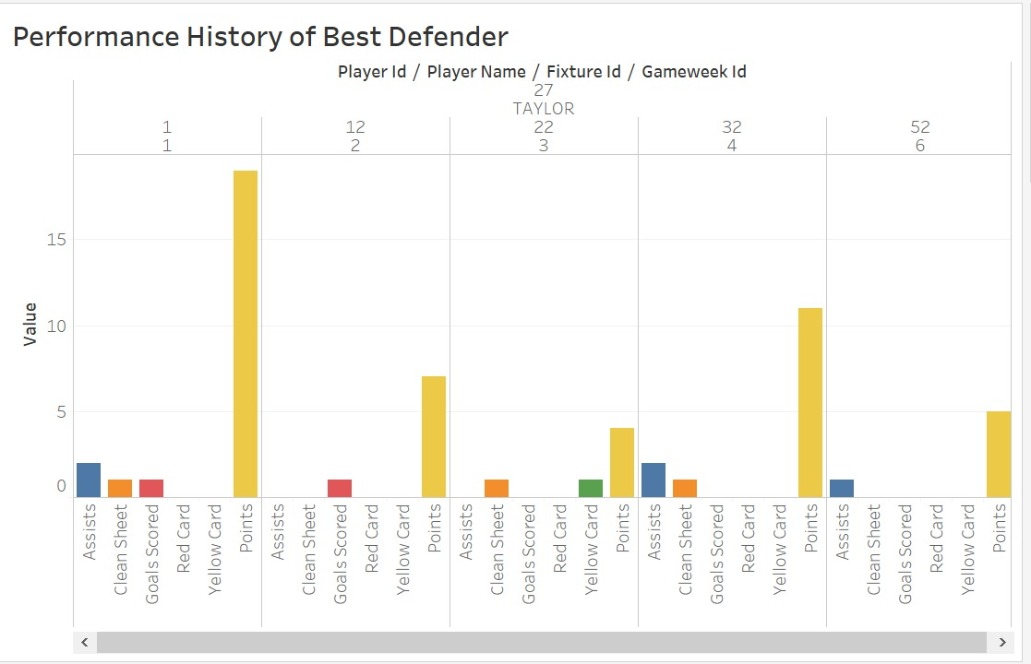
Users Cases
Performance history of overall best defender

Slide 20
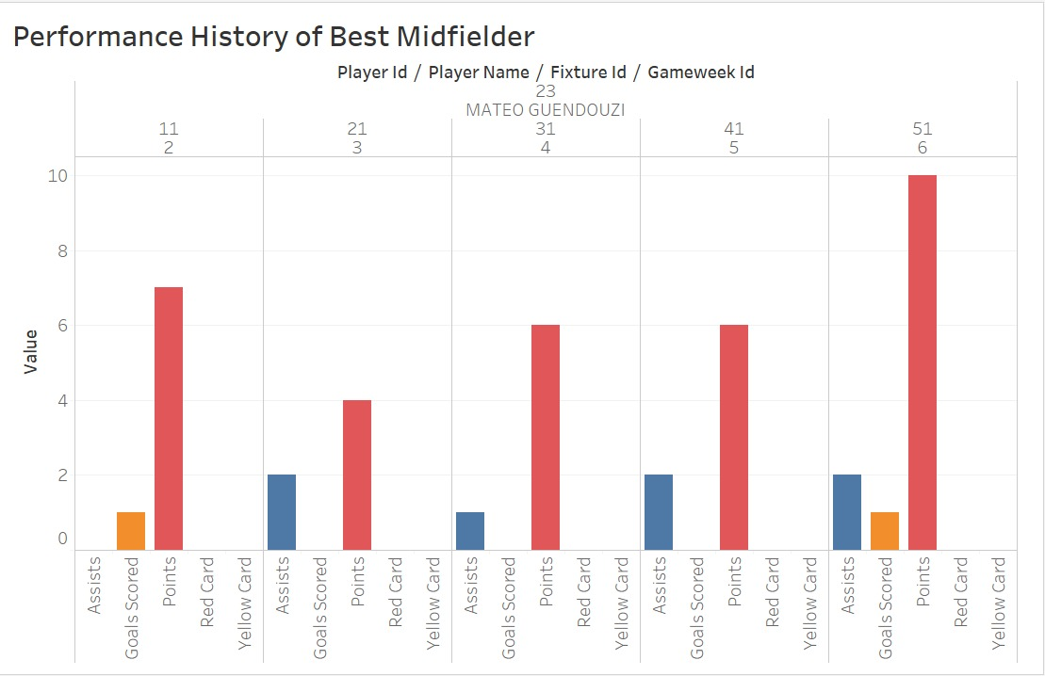
Users Cases
Performance history of overall best midfielder

Slide 21
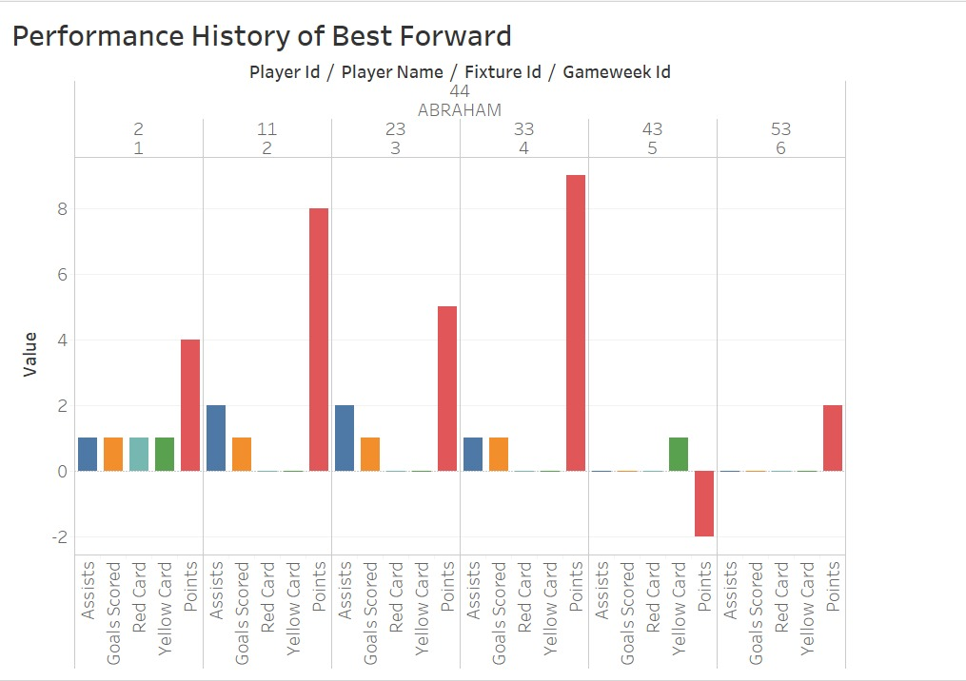
Users Cases
Performance history of overall best forward player

